Slide 1
.budgt where none of your budgeting dreams come true...
The missing “e” is not a typo, were just saving it for later.
Dr Seuss CFO

Slide 2

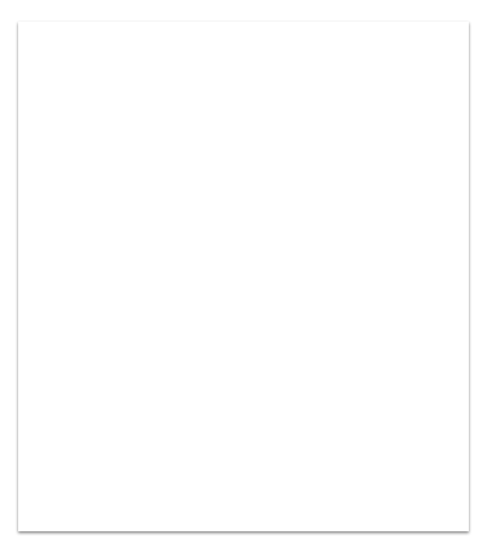
1. Much bug, many error
What does it do? It helps you budget your finances!
No one want to be poor :( This will help you save so you can spend all your cold hard savings on ungrateful family members ar christmas!
It’s simple to use All you have to do is run the app and enter a few numbers!

Slide 3
Through the use of user input, .budgt will give the user a break down of where their money is being spent and on what, in a dollar value as well as a percentage of income! How exciting!
-Bill Gates

Slide 4
end
Tip
Be good to your mother

